Slide 1
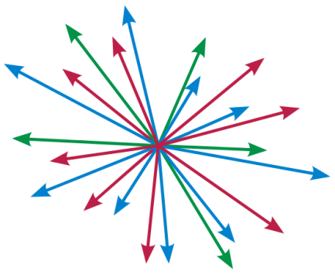

Independence Systems:
New Horizons for an Old Concept
Moran Feldman

Slide 2

Combinatorial Optimization
max w(S)
s.t. S ⊆ N
S obeys a constraint C
Given a ground set N.
Standard Approach
A different algorithm for every type of constraint.
Matching
Maximum Weight Spanning Tree
Independent Set
Another Approach
Define general classes of constraints.
Find an algorithm which is good for every constraint in the class.

Slide 3
Independence Systems
To use this approach, we model a constraint with an independence system.
(N, Ι )
The collection of the feasible subsets of N.
Called independent sets.
Must obey
A ground set of elements
If A ⊆ B and B ∈ Ι, then A ∈ Ι.
The empty set is independent.

Slide 4

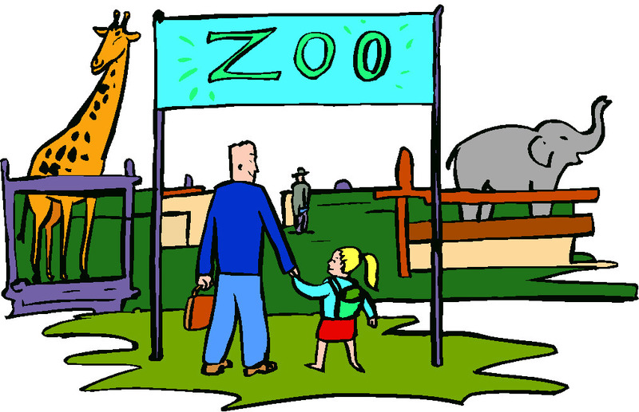
Classes of Independence Systems
Most well known: Matroids
Tends to scare people away (for no good reason)
A large zoo of additional classes:
k-extendible
k-exchange
k-matchoid
k-intersection
etc.
This talk: k-systems
Generalizes all the other classes
Simple definition

Slide 5


k-systems
Terminology
A base B of a subset N’ ⊆ N is an inclusion-wise maximal independent subset of N’.
Matching is a 2-system.
Implies that a maximal matching is a 2-approximation for the maximum matching.
k
Definition
An independence system (N, I) is a k-system if for every subset N’ ⊆ N the ratio between the sizes of the largest and smallest bases of N’ is at most k.
Easy Observations
It is easy to find a base of N.
Such a base is a k-approximation for the problem of finding a maximum size independent set.

Slide 6

Extension to Weighted Problems
We need to choose a maximum weighted base.
Most natural option:
The Greedy Algorithm
Start with the empty solution.
While there are elements that can be added to the solution:
Pick among them the maximum weight one.
Add it to the solution.
Results
Greedy achieves k-approximation for the problem of finding a maximum weight independent set. [Jenkyns 1976]
This is the best possible even for the unweighted problem. [Badanidiyuru and Vondrák 2014]

Slide 7
Analysis of Greedy
It suffices to show that the i-th element picked by Greedy is at least as heavy as one of the k(i-1) + 1 heaviest elements of OPT.
k elements
k elements
k elements
k elements
k elements
k elements
3rd element picked as heavy as these
accounts for these elements
Heavy to light elements
Proof
Let OPT_{i} be the set of the k(i-1) + 1 heaviest elements of OPT.
Let S_{i-1} be the set of the first i-1 elements picked by Greedy.
S_{i-1} cannot be a base of OPT_{i} ∪ S_{i-1} because it is smaller by a factor of more than k compared to the independent set OPT_{i}.
Some element of OPT_{i} can be added to S_{i-1}.

Slide 8
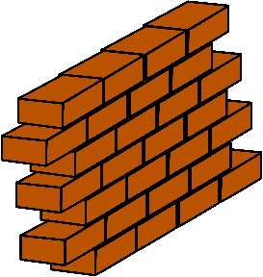
Hardness Intuition
N =
Bad
Elements
Good Elements
I = { }
sets of size at most r and sets of size at most kr including only good elements
Observations
For a better than k approximation we must identify good elements.
To identify good elements, we must find an independent set of size larger than r.
If the good elements are chosen at random, we must check exponentially many sets to find such a set.

Slide 9

Are we done?
The optimal algorithm for the problem was obtained 40 years ago. Then, why do we even talk about the problem?
Over the years there have been some results achieving slightly improved results for special cases.
For example, k/2 for weighted k-set-packing. [Berman 2000]
Greedy is a fairly simple and quick algorithm;
but, in the era of Big Data, it is often not good enough.
Motivates studying the problem in Big Data models:
Map-Reduce
Streaming
Sublinear time
…

Slide 10


(Semi)-Streaming Model
An answer based on the input
Input stream
Algorithm
Elements of the ground set.
Main Obstacle
The algorithm should use little memory.
For a semi-streaming algorithm: linear in the maximum size of a possible output, up to a polylogarithmic factor.

Slide 11

Streaming in the Unweighted Case
We can still kind a base by starting with the empty solution, and adding every arriving element if this does not violate independence.
Achieves the optimal k-approximation.
This is the best known
even for the very special
case of bipartite matching.

Slide 12
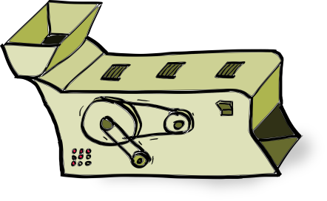
Algorithm for the Weighted Case
We make the simplifying assumption that all the weights are integral powers of (1 + ε) between 1 and n² for an arbitrary small constant ε > 0.
Can be removed via standard reductions at the cost of increasing the approximation ratio by O(ε).
Step 1
For every i between 0 and 2 log_{1+ε} n, find a base B_{i} of the elements whose weight is at least (1 + ε)^{i}. Let E_{i} denote the set of these elements.
Observation
The size of B_{i} is at least |E_{i} ∩ OPT| / k.

Slide 13
Algorithm for the… (cont.)
Step 2
Run the greedy algorithm on the union of the B_{i}’s.
Approximation Ratio Analysis
Let S_{i} be the solution of greedy after adding the last element of weight (1 + ε)^{i}.
Observe that S_{i} is a base of (∪_{j} B_{j}) ∩ E_{i}.
Thus, |S_{i}| ≥ |B_{i} ∩ E_{i}| / k = |B_{i}| / k ≥ |OPT ∩ E_{i}| / k².
In other words, the number of elements in the solution of weight (1 + ε)^{i} is at least as large as the number of such elements in OPT, up to a factor of k^{2.}
One can observe that this implies k²-approximation.

Slide 14

Warping It Up
Space Analysis
Our algorithm stores log_{1+ε} n² = O(ε⁻¹ ∙ log n) independent sets (the bases B₀, B₁, B₂, …).
For a constant ε, this is a poly-logarithmic term, so the algorithm is a semi-streaming algorithm.
It is unknown whether this is tight.
For many special cases Õ(k)-approximation is known.
Theorem [Crouch and Stubbs (2014)]
There is a (k² + ε)-approximation semi-streaming algorithm for the problem of finding a maximum weight independent set in a k-system.

Slide 15
Questions
?
?
?
?
?

